Slide 1

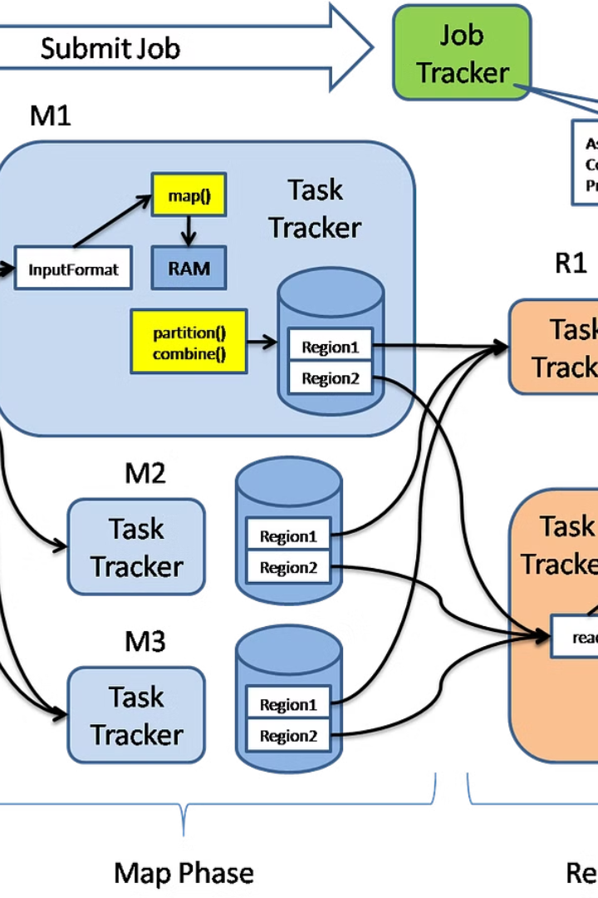


Introduction to Map Reduce programming
In Java, MapReduce programming for big data computing involves several key concepts and components. From the map and reduce functions to the shuffle and sort phase, this type of programming is essential for processing and analyzing large datasets efficiently.
by Rohit Chapalamadugu

Slide 2
Key concepts of Map Reduce
Map Function
Reduce Function
Shuffle and Sort Phase
The map function is responsible for taking in key-value pairs and processing them to generate intermediate key-value pairs to be input into the reduce function.
The reduce function is crucial for taking the output from the map function and combining or reducing the data into a smaller set of key-value pairs.
This phase is responsible for organizing the output of the map function to ensure that all the values associated with a single key are grouped together before being passed to the reduce function.

Slide 3
Map function
1
Key-Value Pair Processing
2
Data Transformation
3
Parallel Execution
The map function allows for parallel execution of its tasks, which is essential for handling large datasets effectively.
The map function takes in key-value pairs and processes them to generate intermediate key-value pairs.
It's responsible for transforming the input data into the desired format for the reduce function to process efficiently.

Slide 4
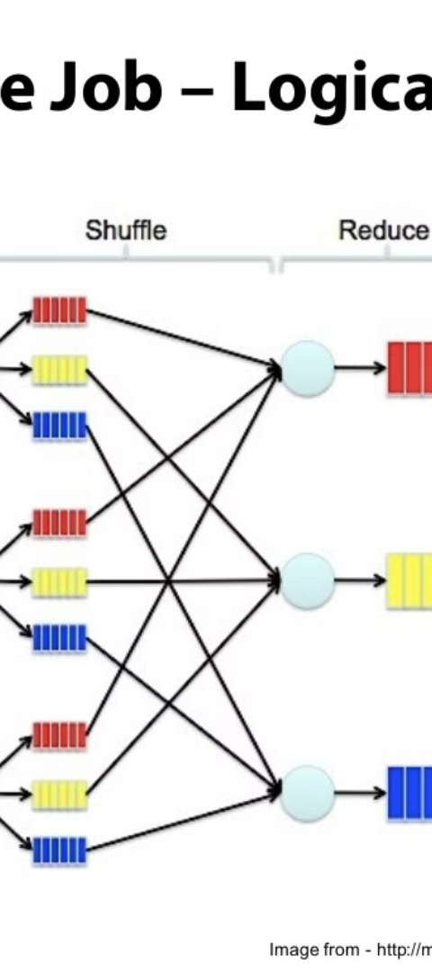
Reduce function
1
Aggregation
The reduce function aggregates and combines the intermediate data generated by the map function.
2
Data Reduction
It reduces the set of intermediate values which share a key to a smaller set of values.
3
Final Output
The final output from the reduce function is the result of processing all the values associated with a particular key.

Slide 5
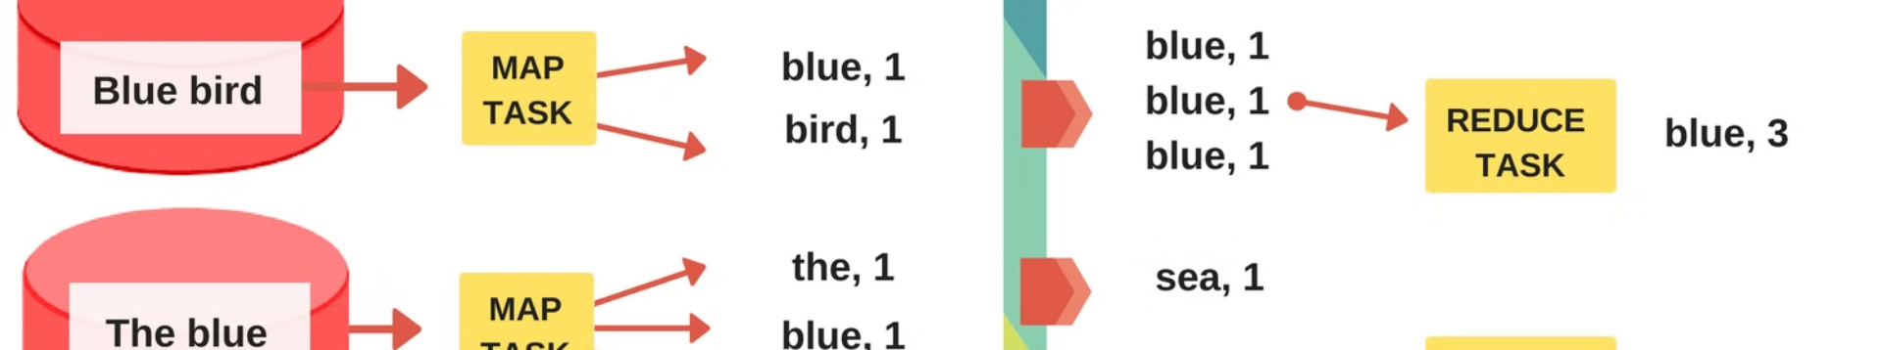



Shuffle and Sort phase
Shuffle
Sort
Partition
During this phase, the key-value pairs from the map function are shuffled across the cluster.
The shuffled data is sorted such that all values associated with a single key are grouped together.
The partitioning of the data is done to ensure that each reducer gets the relevant key-value pairs.

Slide 6
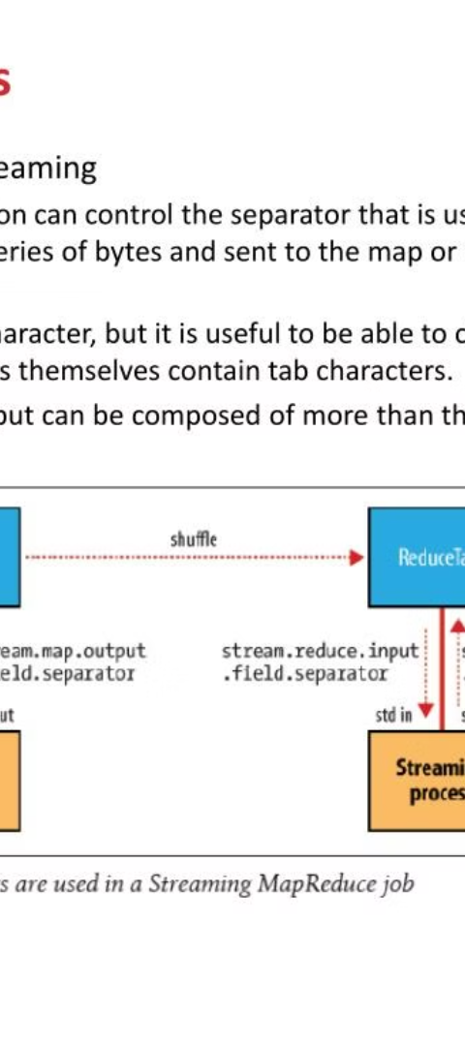
Input and Output formats
Input Formats
Output Formats
The input formats are responsible for reading data from external sources and converting it into key-value pairs.
The output formats are used for writing the final results to external storage systems.

Slide 7
Job configuration and execution
1
2
Configuration Setup
Job Submission
The job configuration involves setting up the input/output paths, mapper/reducer classes, and other job-specific parameters.
Once the configuration is finalized, the job is submitted to the Hadoop cluster for execution.

Slide 8




Example of a Map Reduce program
Programming Language
Code Development
Big Data
Data Analytics
Map Reduce programming is essential for processing and analyzing large datasets or big data.
The output of Map Reduce programs can be used for in-depth data analysis and insights.
Map Reduce programs can be written in Java, making it a versatile language for big data processing.
Developing Map Reduce programs requires strong coding skills and a deep understanding of distributed systems.

